Slide 1


CAPSTONE PROJECT
Credit Card Default Prediction
-BY AAKASH CHAUHAN
-INTERN AT PICKL.AI

Slide 2
CONTENT
➢ BUSINESS UNDERSTANDING
➢ DATA SUMMARY
➢ FEATURE ANALYSIS
➢ EXPLORATORY DATA ANALYSIS
➢ DATA PREPROCESSING
➢ IMPLEMENTING ALGORITHMS
➢ CHALLENGES
➢ CONCLUSIONS

Slide 3
BUSINESS UNDERSTANDING
➢ In today’s world credit cards have become a lifeline to a lot of people so banks provide us with credit cards. Now we know the most common issue there is in providing these kind of deals are people not being able to pay the bills. These people are what we call “defaulters”.
➢ Credit card default happens when you have become severely delinquent on your credit card payments. Missing credit card payments once or twice does not count as a default. A payment default occurs when you fail to pay the Minimum Amount Due on the credit card for a few consecutive months
➢ Objective of our project is to predict which customer might default in upcoming months.

Slide 4
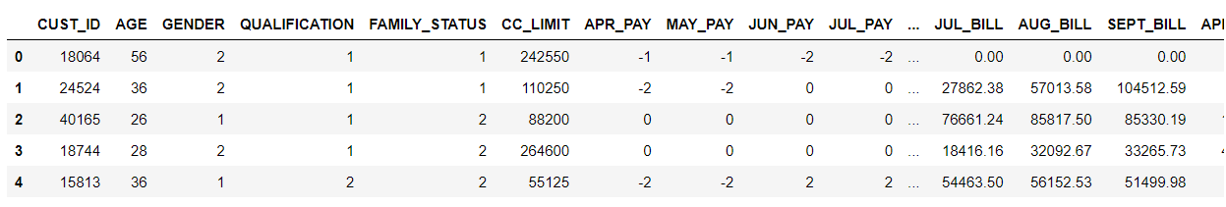
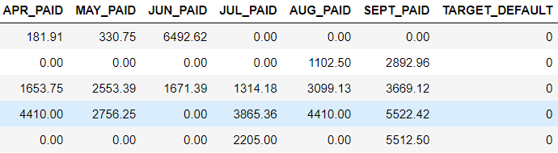
DATA SUMMARY

Slide 5
FEATURE SUMMARY
➢ X1 –CC Limit
➢ X2 –Gender
➢ X3 –Qualification
➢ X4 –Family Status
➢ X5 -Age
➢ X6 to X11 -History of past payments from April to September
➢ X12 to X17 -Amount of bill statement from April to September
➢ X18 to X23 -Amount of previous payment from April to September
➢ Y –Target Default

Slide 6
INSIGHTS FROM OUR DATASET
➢ In our data set there are 10,000 rows, 25 columns
➢ There are No Missing Values present
➢ There are No Duplicate values present
➢ There are No null values.
➢ And finally we have ‘Target Default' variable which we need to predict for new observations
➢ 9 Categorical variables present.
➢ 6 Months payment and bill data available.
➢ The Columns are: - CUST_ID, AGE, GENDER, QUALIFICATIONS, FAMILY_STATUS, CC_LIMIT, APR_PAY, MAY_PAY, JUN_PAY, JUL_PAY, AUG_PAY, SEPT_PAY, APR_BILL, MAY_BILL, JUN_BILL, JUL_BILL, AUG_BILL, SEPT_BILL, APR_PAID, MAY_PAID, JUN_PAID, JUL_PAID, AUG_PAID, SEPT_PAID,TARGET_DEFAULT

Slide 7
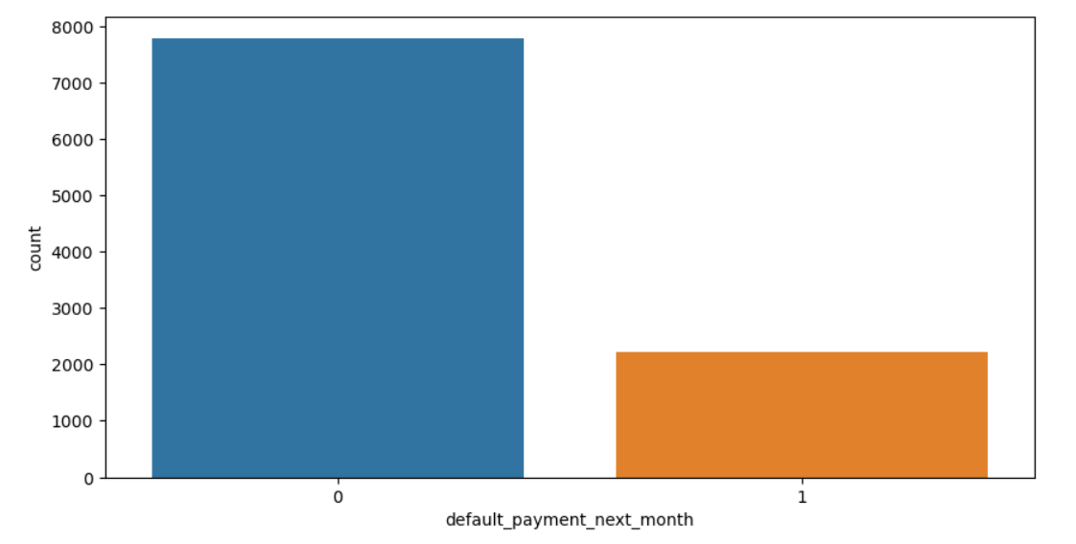
ANALYSIS OF DEPENDENT VARIABLE
➢ As we can see from above graph that both classes are not in proportion and we have imbalanced dataset. we need to do normalize the data in next step.
● 0 23364
● 1 6636
● 0 - Not Default
● 1 - Default

Slide 8
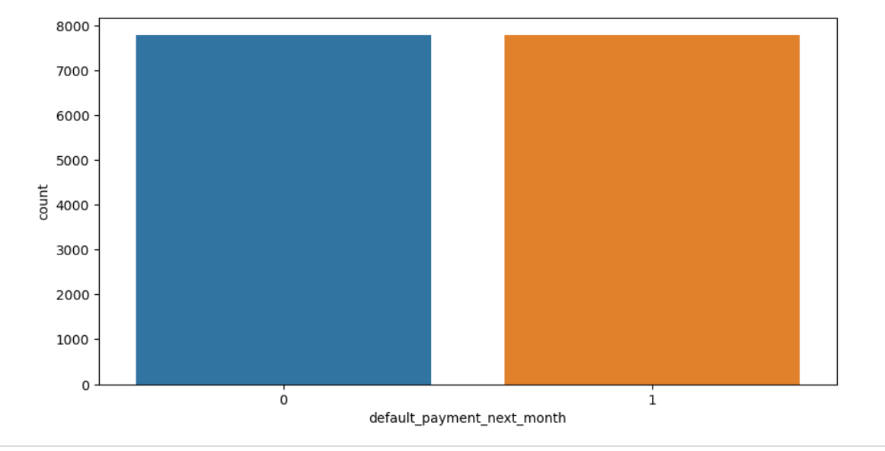
SMOTE
➢ SMOTE (Synthetic Minority Oversampling Technique) – Oversampling is one of the most commonly used oversampling methods to solve the imbalance problem. It aims to balance class distribution by randomly increasing minority class examples by replicating them.
➢ After performing SMOTE operation we get this balance dataset.

Slide 9
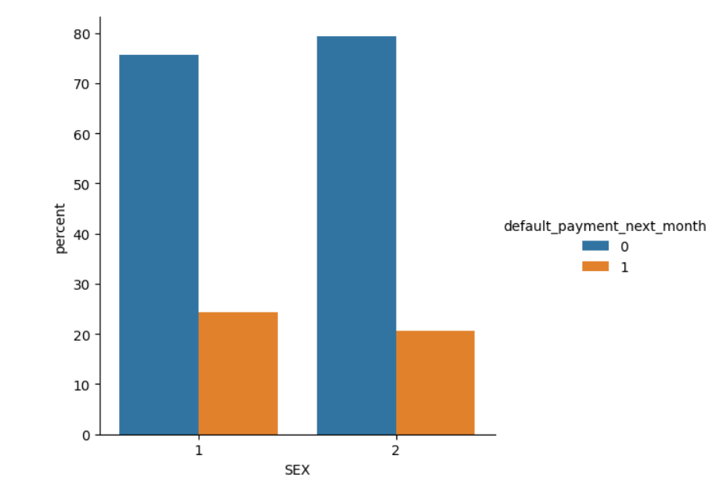
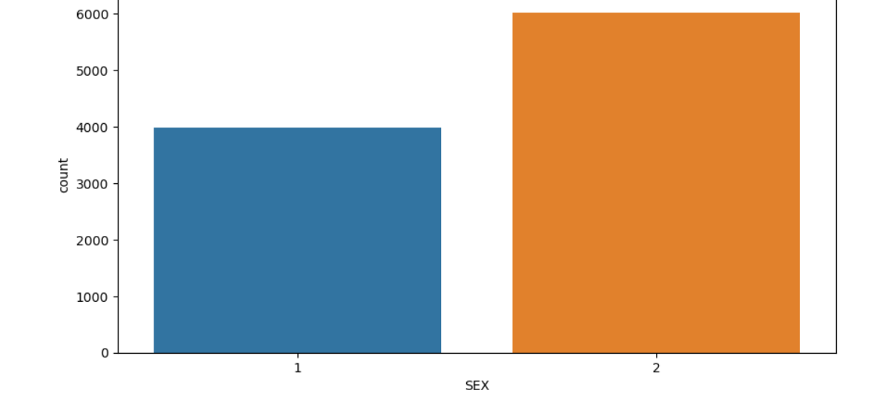
ANALYSIS OF GENDER VARIABLE
➢ 1 - Male 2 - Female
➢ Number of Male credit holders is less than Females.
➢ It is evident from the above graph that the number of defaulters has a high proportion of males.

Slide 10
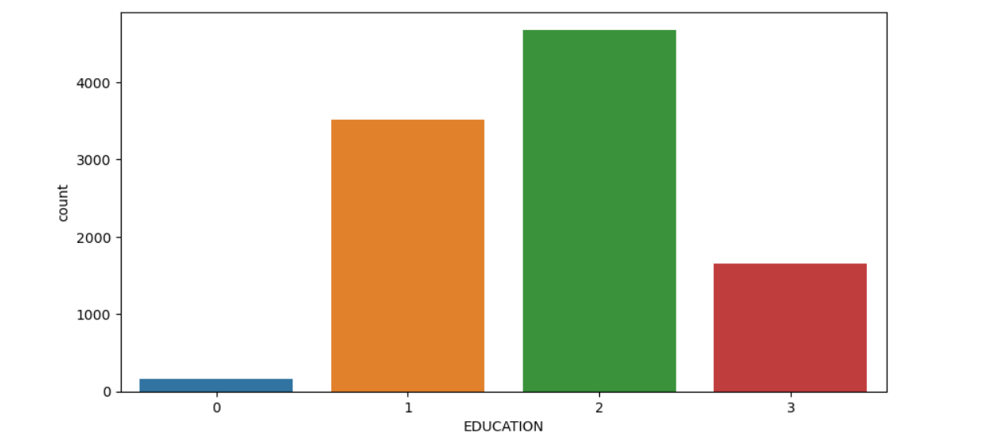
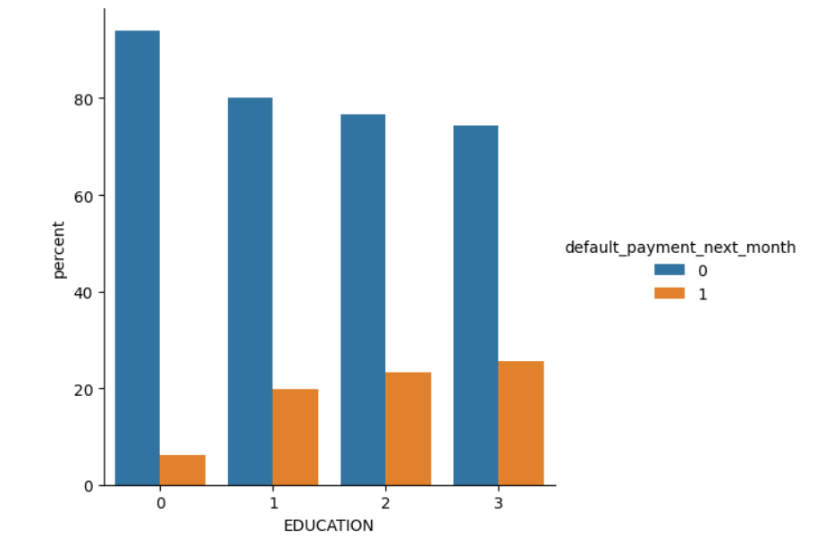
ANALYSIS OF QUALIFICATION VARIABLE
➢ 1=High school, 2=Graduate, 3=Post graduate, 0=others
➢ From the above-left side plot we can say that
➢ More number of credit holders are graduate students followed by High school and then by postgraduate students.
➢ From the right side plot it is clear that those people who are postgraduate students have higher default payments wrt graduates and other people.

Slide 11
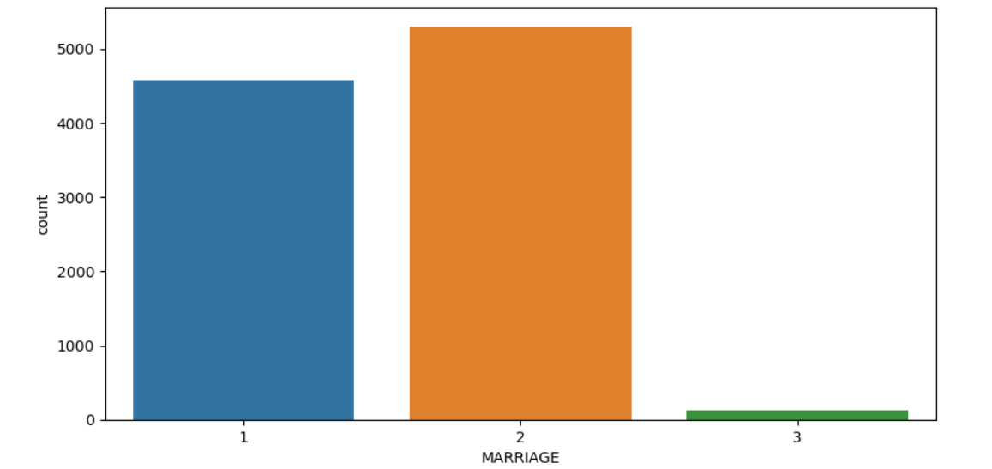
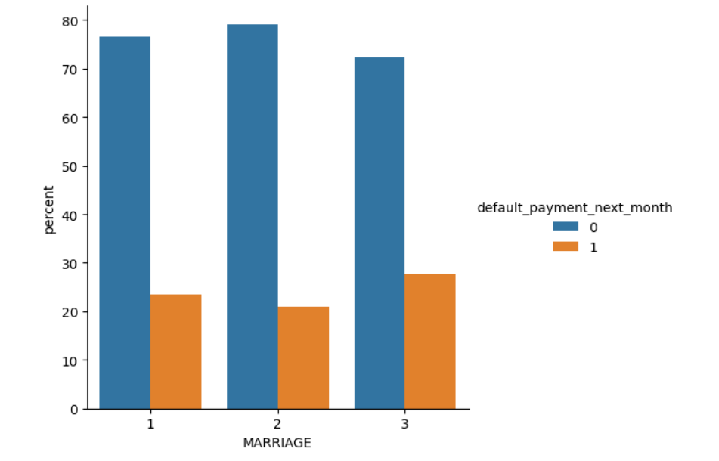
ANALYSIS OF FAMILY STATUS VARIABLE
➢ 1 - married 2 - single 3 - others
➢ From the above data analysis we can say that
➢ More credit cards holder are Single.
➢ High defaulter rate when it comes to others.

Slide 12
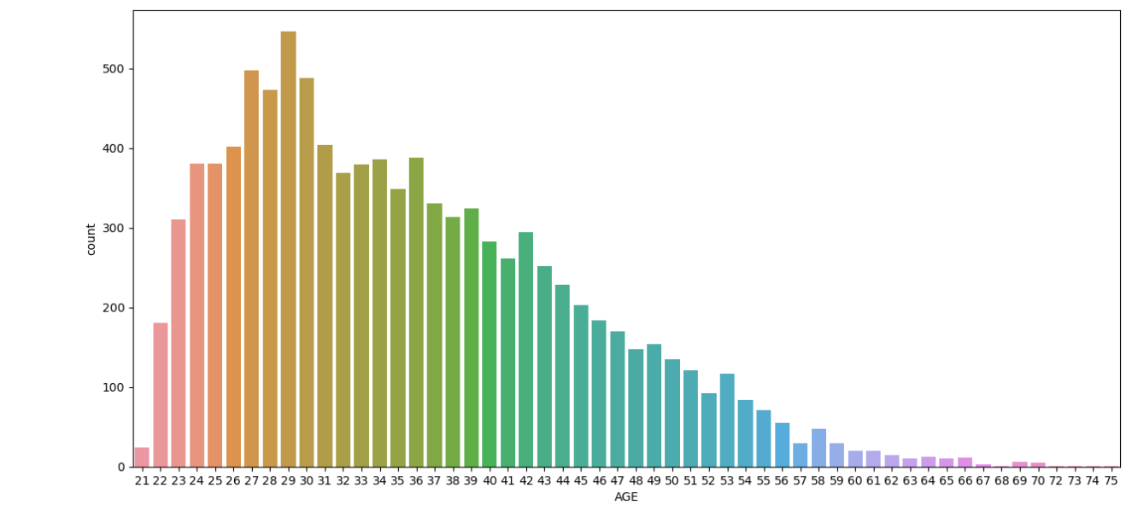
ANALYSIS OF AGE VARIABLE
From the above count plot analysis we can say that
● We can see more credit cards holder age are between 26-30 years old.
● Age above 60 years old rarely uses credit cards.

Slide 13
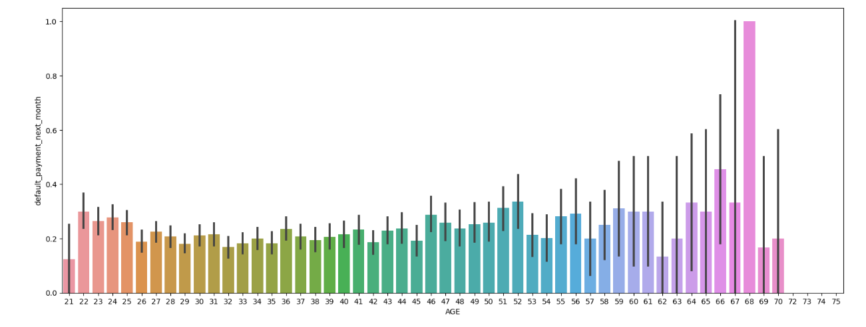
ANALYSIS OF AGE VARIABLE
From the above bar plot which shows the relationship between age and defaulter, we can say that
● Those who default are 60 years and older, that may be because they don’t use their card frequently

Slide 14
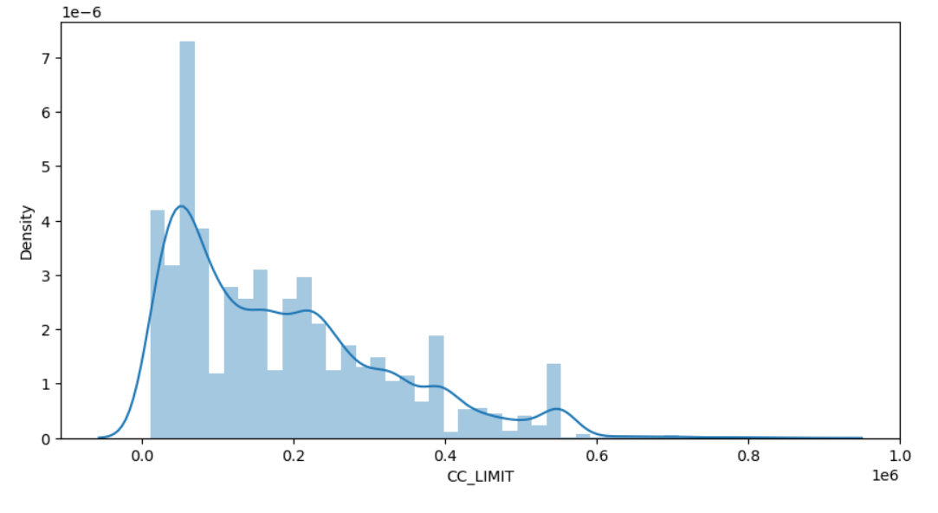
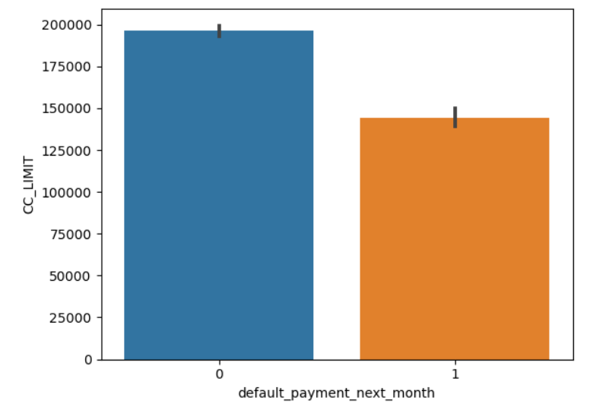
ANALYSIS OF LIMIT BALANCE VARIABLE
From the above data analysis, we can say that
Maximum amount of given credit is 40,000 followed by 30,000 and 20,000

Slide 15
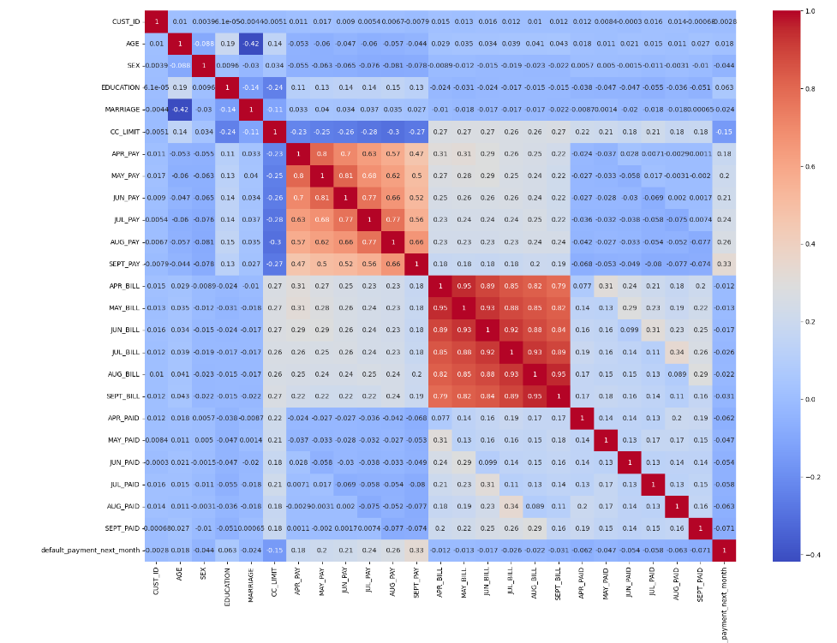
CHECKING OF CORRELATION

Slide 16
ONE HOT ENCODING
● One hot encoding is a process by which categorical variables are converted into a form that could be provided to ML algorithms to do a better job in prediction.
● here we perform one hot encoding on ‘QUALIFICATION’, ‘FAMILY STATUS’, 'SEPT_PAY', ‘AUG_PAY', 'JUL _PAY ', 'JUN _PAY ', 'MAY _PAY ', 'APR _PAY’.
● and label encoding for ‘GENDER’
● After this we get these features in our dataset:
['AGE', 'SEX', 'CC_LIMIT', 'APR_BILL', 'MAY_BILL', 'JUN_BILL', 'JUL_BILL', 'AUG_BILL', 'SEPT_BILL', 'APR_PAID', 'MAY_PAID', 'JUN_PAID', 'JUL_PAID', 'AUG_PAID', 'SEPT_PAID', 'default_payment_next_month', 'total_Payement_Value', 'Dues', 'EDUCATION_graduate school', 'EDUCATION_high school', 'EDUCATION_others', 'EDUCATION_university', 'MARRIAGE_married', 'MARRIAGE_others', 'MARRIAGE_single', 'SEPT_PAY_-1', 'SEPT_PAY_0', 'SEPT_PAY_1', 'SEPT_PAY_2', 'SEPT_PAY_3', 'SEPT_PAY_4', 'SEPT_PAY_5', 'SEPT_PAY_6', 'SEPT_PAY_7', 'SEPT_PAY_8', 'AUG_PAY_-1', 'AUG_PAY_0', 'AUG_PAY_1', 'AUG_PAY_2', 'AUG_PAY_3', 'AUG_PAY_4', 'AUG_PAY_5', 'AUG_PAY_6', 'AUG_PAY_7', 'JUL_PAY_-1', 'JUL_PAY_0', 'JUL_PAY_1', 'JUL_PAY_2', 'JUL_PAY_3', 'JUL_PAY_4', 'JUL_PAY_5', 'JUL_PAY_6', 'JUL_PAY_7', 'JUN_PAY_-1', 'JUN_PAY_0', 'JUN_PAY_1', 'JUN_PAY_2', 'JUN_PAY_3', 'JUN_PAY_4', 'JUN_PAY_5', 'JUN_PAY_6', 'JUN_PAY_7', 'MAY_PAY_-1', 'MAY_PAY_0', 'MAY_PAY_1', 'MAY_PAY_2', 'MAY_PAY_3', 'MAY_PAY_4', 'MAY_PAY_5', 'MAY_PAY_6', 'MAY_PAY_7', 'APR_PAY_-1', 'APR_PAY_0', 'APR_PAY_1', 'APR_PAY_2', 'APR_PAY_3', 'APR_PAY_4', 'APR_PAY_5', 'APR_PAY_6', 'APR_PAY_7', 'APR_PAY_8']

Slide 17
MODEL BUILDING
➢ LOGISTIC REGRESSION
➢ RANDOM FOREST
➢ SVM
➢ DECISION TREE

Slide 18
LOGISTIC REGRESSION
PARAMETERS : {'C’: 10, 'penalty': 'l2'}
from the above evalution, we get the results below
The accuracy of test data is 0.7515576323987538
The precision on test data is 0.6779595015576324
The recall on test data is 0.7949771689497717
The f1 on test data is 0.7318200924758302
The roc_score on test data is 0.7571287745631411

Slide 19
RANDOM FOREST
PARAMETERS : {'max_depth': 30, 'n_estimators’: 200}
From the above evaluation, we get the results below
The accuracy on test data is 0.8368380062305296
The precision on test data is 0.8020752269779508
The recall on test data is 0.8574380165289256
The f1 on test data is 0.8319967923015236
The roc_score on test data is 0.8379605399286748
After grid-search, we get f1-sore approx. 82%. As we have an imbalanced dataset, F1- score is a better parameter. Let's go ahead with other models and see if they can yield better result.

Slide 20
SVM
From the above evaluation we get the results below
The accuracy on test data is 0.7702492211838006.
The precision on test data is 0.6985981308411215.
The recall on test data is 0.815454545454545.
The f1 on test data is 0.7525167785234899.
The roc_score on test data is 0.7759152836264553.

Slide 21
DECISION TREE CLASSIFIER
PARAMETERS:{CRITERION: ‘ENTROPY’, MAX_DEPTH=10}
from the above evalution, we get the results below
The accuracy of test data is 0.7007398753894081.
The precision on test data is 0.5845015576323987.
The recall on test data is 0.7615423642820903.
The f1 on test data is 0.661379158404935.
The roc_score on test data is 0.661379158404935.

Slide 22
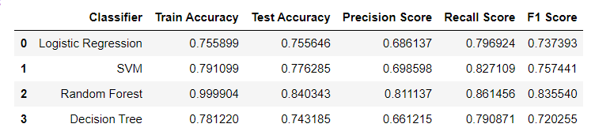
EVALUATING THE MODELS

Slide 23
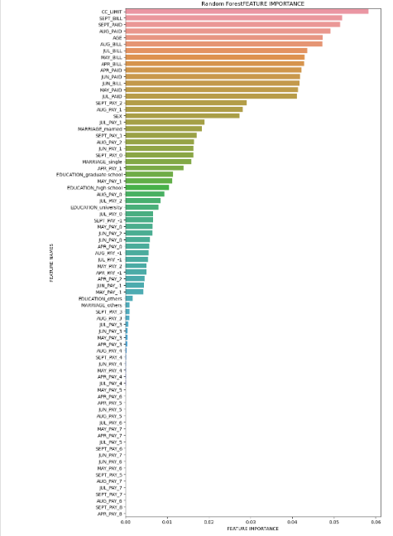
FEATURE IMPORTANCE

Slide 24
FEATURE IMPORTANCE
From this graph we can see that in random forest CC_Limit, SEPT_LIMIT, SEPT_PAID are the strongest predictor of future default payment.

Slide 25
CHALLENGES
➢ Feature engineering
➢ Getting a higher accuracy on the models.
➢ Carefully handled feature-imbalanced data
➢ Carefully tuned Hyperparameters.

Slide 26
CONCLUSION
➢ Recent SEPT LIMIT ,SEPT PAID and credit limit are the strongest default predictors.
➢ Recall is the best accuracy metric here because if the algorithm will not detect the defaulters, they will encounter more loss to the bank.
➢ Random Forest also had the best score as well but this leads to overfitting the data.
➢ Decision Tree being the least accurate with a recall of 79%.
➢ Higher recall can be achieved if low precision is acceptable.
➢ This Model can only be served as an aid in decision-making instead of replacing human decisions.
➢ Model can be improved with more data.

Slide 27
THANK YOU

